Slide 1
2- Conditional Statements

Slide 2

In almost every program, there are times you need to make decisions, and that's when you use an if statement.
if we add a condition, which is basically a boolean expression, an expression that produces a boolean value.
When you use an if statement, you should always terminate your statement with a colon.
when I press enter, our cursor is in indented, so here we have two white spaces.
This is very important because using these indentations, Python interpreter will know what statements should be executed.

Slide 3

so we can have as many statements as we want here as long as there are indented, they belong to this if block.

Slide 4
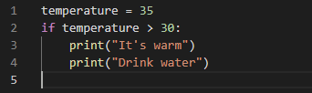
when we finish here, we should remove indentation to indicate the end of this if block.

Slide 5



Slide 6

time, look, this Done message is executed whether our condition is true or not.
So pay great attention to these indentations.

Slide 7
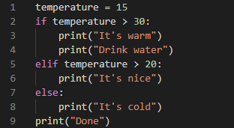

what if you want to have multiple conditions?
we use an elif statement. That is short for else if.

